Slide 1
Lecture 9alt
Combinational ATPG
(A Shortened version of Original Lectures 9-12)
ATPG problem
Algorithms
  Multi-valued algebra
  D-algorithm
  Podem
ATPG system
Summary
Exercise

Slide 2
ATPG Problem
ATPG: Automatic test pattern generation
  Given
    A circuit (usually at gate-level)
    A fault model (usually stuck-at type)
  Find
    A set of input vectors to detect all modeled faults.
Core problem: Find a test vector for a given fault.
Combine the “core solution” with a fault simulator into an ATPG system.

Slide 3
What is a Test?
Fault activation
Fault effect
X
1
0
0
1
0
1
X
X
Combinational circuit
1/0
1/0
Primary inputs
(PI)
Primary outputs
(PO)
Path sensitization
Stuck-at-0 fault

Slide 4
ATPG is a Search Problem
Search the input vector space for a test:
    Initialize all signals to unknown (X) state – complete vector space is the playing field
    Activate the given fault and sensitize a path to a PO – narrow down to one or more tests
Vector
Space
Vector
Space
Circuit
Circuit
X
X
X
X
0
1
sa1
sa1
0/1
001 101

Slide 5
Need to Deal With Two Copies of the Circuit
Good circuit
X
0
1
X
Alternatively, use a multi-valued
algebra of signal values for both
good and faulty circuits.
0
Same input
Different outputs
Circuit
Faulty circuit
X
0
1
X
X
0
1
X
sa1
1
sa1
0/1

Slide 6
Multiple-Valued Algebras
Symbol
D
D
0
1
X
G0
G1
F0
F1
Alternative
Representation
1/0
0/1
0/0
1/1
X/X
0/X
1/X
X/0
X/1
Fault-free
circuit
1
0
0
1
X
0
1
X
X
Faulty
Circuit
0
1
0
1
X
X
X
0
1
Roth’s
Algebra
Muth’s
Additions

Slide 7
Function of NAND Gate
c |  | Input a
 |  | 0 | 1 | X | D
 | 0 | 1 | 1 | 1 | 1 | 1
 | 1 | 1 | 0 | X |  | D
 | X | 1 | X | X | X | X
 | D | 1 |  | X |  | 1
 |  | 1 | D | X | 1 | D
D
D
1/0
0/1
a
b
1
c
D
D
Input b
D
D
D

Slide 8
D-Algorithm
(Roth et al., 1967, D-alg II)
Use D-algebra
Activate fault
    Place a D or D at fault site
    Do justification, forward implication and consistency check for all signals
Repeatedly propagate D-chain toward POs through a gate
    Do justification, forward implication and consistency check for all signals
Backtrack if
    A conflict occurs, or
    D-frontier becomes a null set
Stop when
    D or D at a PO, i.e., test found, or
    If search exhausted without a test, then no test possible

Slide 9
Definitions
Justification: Changing inputs of a gate if the present input values do not justify the output value.
Forward implication: Determination of the gate output value, which is X, according to the input values.
Consistency check: Verifying that the gate output is justifiable from the values of inputs, which may have changed since the output was determined.
D-frontier: Set of gates whose inputs have a D or D, and the output is X.

Slide 10
Definition: Singular Cover
A singular cover defines the least restrictive inputs for a deterministic output value.
Used for:
    Line justification: determine gate inputs for specified output.
    Forward implication: determine gate output.
a
b
X
X
Singular covers | a | b | c
SC-1 | 0 | X | 1
SC-2 | X | 0 | 1
SC-3 | 1 | 1 | 0
0
c
Examples: XX0 ∩ 110 = 110
0XX ∩ 0X1 = 0X1

Slide 11
Definition: D-Cubes
D-cubes are singular covers with five-valued signals
Used for D-drive (propagation of D through gates) and forward implication.
D-cube | a | b | c
D-1 | D | 1
D-2 | 1 | D
D-3 |  | 1 | D
D-4 | 1 |  | D
D-5 | D | D
D-6 |  |  | D
D-7 | D | 0 | 1
D-8 | 0 | D | 1
D-9 | D |  | 1
D-10 |  | D | 1
D
D
D
D
D
a
b
X
D
D
D
X
c
Examples: XDX ∩ 1DD = 1DD
0DX ∩ 0D1 = 0D1
DDX ∩ DD1 = DD1
D
D

Slide 12
D-Intersection
∩ | 0 | 1 | X | D
0 | 0 |  | 0
1 |  | 1 | 1
X | 0 | 1 | X | D
D |  |  | D | D
Undefined
State
(conflict)
D
D
D
D
D

Slide 13
An Example: XOR
a2
a1
d
e
c1
c
c2
a
b
f
b1
b2
Find tests for: c sa0
c1 sa0
c2 sa0

Slide 14
XOR: Test for c sa0
a2
a1
d
e
c1
c
c2
a
b
f
b1
b2
Action Operation D-frontier
Activate fault c=1 or c=c1=c2=D d, e
Justify c=1 XX1 ∩ 0X1 = 0X1, a=a1=a2=0 d, e
Forward impl a2=0 0DX ∩ 0D1= 0D1, d=1 e
Forward imp d=1 1XX ∩ XXX= 1XX , no implication possible e
D-drive c2→e DXX ∩ D1D= D1D, b2=b=b1=1, e=D f
Forward impl b1=1 011 ∩ 0X1 = 011, consistency checked f
D-drive e→f 1DX ∩ 1DD = 1DD, f=D PO
Stop, test found Test: (a,b) = (0, 1), f = 1

Slide 15
Finding Other Detected Faults by the Generated Test
Use any fault simulator:
    Serial
    Deductive
    Concurrent
    Other
Test-Detect: A simple fault simulation algorithm
    Uses true-value simulation
    Uses D-algebra for fault analysis
    Roth et al., 1967

Slide 16
Test-Detect: XOR, Test (0,1)
Determine good circuit signal values.
For each fault
    Place a D or D at the fault site
    Perform forward implications
    Fault is detected if any PO assumes a D or D value
D for c1 sa0
0DX ∩ 0D1 = 0D1 (null D-frontier) → c1 sa0 not
detected
a2
a1
1
d
e
0
1
c1
c
c2
a
b
1
f
b1
b2
1
D
b1
b2
0
D
1DX ∩ 1DD = 1DD, D at PO →
c2 sa0 is detected
D for c2 sa0
D1X ∩ D1D = D1D

Slide 17
XOR: Test for c1 sa0
a2
a1
d
e
c1
c
c2
a
b
f
b1
b2
Action Operation D-frontier
Activate fault c1=1 or c=c2=1, c1=D d
Justify c=1 XX1 ∩ 0X1 = 0X1, a=a1=a2=0 d
Forward impl a2=0 0DX ∩ 0D1= 0D1, d=1 null
Back-up, redo step 3 No choice available null
Back-up, redo step 2 XX1 ∩ X01 = X01, b=b1=b2=0, a=X, d=X d
Forward impl b2=0 10X ∩ X01 = 101, e=1 d
Forward impl e=1 X1X ∩ XXX = X1X, no implication possible d
D-drive c1→d XDX ∩ 1DD= 1DD, a2=a=a1=1,d=D f
Forward impl a1=1 101 ∩ X01 = 101, consistency checked f
Forward impl d=D D1X ∩ D1D = D1D, f=D PO
Stop, test found Test: (a,b) = (1, 0), f = 1

Slide 18
Complexity of D-Alg II
Signal values on all lines (PIs and internal lines) are manipulated using 5-valued algebra.
Worst-case combinations of signals that may be tried is 5^{#lines}
    For XOR circuit, 5¹² = 244,140,625.
Podem: A reduced-complexity ATPG algorithm
    Recognizes that internal signals depend on PIs.
    Only PIs are independent variables and should be manipulated.
    Because faults are internal, a PI can assume only 3 values (0, 1, X).
    Worst-case combinations = 3^{#PI}; for XOR circuit, 3² = 8.

Slide 19
Podem (Goel, 1981)
Podem: Path oriented decision making
Step 1: Define an objective (fault activation, D-drive, or line justification)
Step 2: Backtrace from site of objective to PIs (use testability measure guidance) to determine a value for a PI
Step 3: Simulate logic with new PI value
    If objective not accomplished but is possible, then continue backtrace to another PI (step 2)
    If objective accomplished and test not found, then define new objective (step 1)
    If objective becomes impossible, try alternative backtrace (step 2)
Use X-PATH-CHECK to test whether D-frontier still there – a path of X’s from a D-frontier to a PO must exist.

Slide 20
XOR Example Again
Compute SCOAP testability measures: (CC0,CC1)CO
6
(4,2)3
5
(1,1)6
7
(3,2)5
(5,5)0
7
(1,1)6
5
6
(4,2)3

Slide 21
Podem: Objective and Backtrace
2&3. Backtrace to a PI
and simulate
1. Objective 1: set fault site to 1
6
(4,2)3
5
1
(1,1)6
7
(3,2)5
sa0
0
D
(5,5)0
7
1
(1,1)6
5
6
X-path check fails
→ Back up:
Erase effects of steps 2&3
Try alternative backtrace
(4,2)3

Slide 22
Podem: Back up
4&5. Alt. backtrace to a PI
and simulate
1. Objective 1: set fault site to 1
6
(4,2)3
5
(1,1)6
7
(3,2)5
sa0
D
(5,5)0
0
1
(1,1)6
7
5
X-path
1
X-path check: OK
Objective 1 achieved
6
(4,2)3

Slide 23
Podem: D-Drive
5. Backtrace to a PI
and simulate
4. Objective 2: D-drive, set line to 1
6
(4,2)3
1
D
5
(1,1)6
7
(3,2)5
sa0
1
D
(5,5)0
7
0
1
D
(1,1)6
5
1
D at PO
→Test found
6
(4,2)3

Slide 24
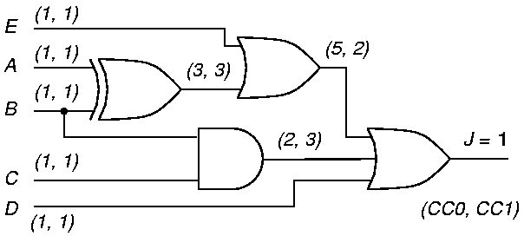
Another Podem Example
3. Logic simulation for A=0
2. Backtrace “A=0”
1. Objective “0”
0
S-a-1
(9, 2)
4. Objective possible but not accomplished

Slide 25
Podem Example (Cont.)
6. Logic simulation for A=0, B=0
5. Backtrace “B=0”
1. Objective “0”
0
0
0
S-a-1
0
(9, 2)
7. Objective possible but not accomplished

Slide 26
Podem Example (Cont.)
9. Logic simulation for E=0
8. Backtrace “E=0”
1. Objective “0”
0
0
0
0
0
S-a-1
0
(9, 2)
10. Objective possible but not accomplished

Slide 27
Podem Example (Cont.)
12. Logic simulation for D=0
1. Objective “0”
0
0
0
0
0
S-a-1
0
0
(9, 2)
0
13. Objective accomplished
11. Backtrace “D=0”

Slide 28
An ATPG System
Random pattern
generator
Fault simulator
yes
Fault
coverage
improved?
Random
patterns
effective?
Deterministic
ATPG (D-alg.
or Podem)
Save
patterns
yes
no
no
yes
no
Compact
vectors
Coverage
Sufficient?

Slide 29
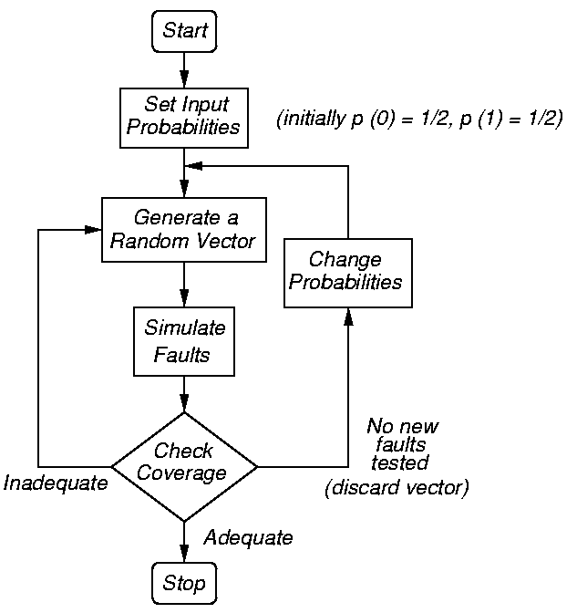
Random-Pattern Generation
Easily gets tests for 60-80% of faults
Then switch to D-algorithm, Podem, or other ATPG method

Slide 30
Vector Compaction
Objective: Reduce the size of test vector set without reducing fault coverage.
Simulate faults with test vectors in reverse order of generation
    ATPG patterns go first
    Randomly-generated patterns go last (because they may have less coverage)
    When coverage reaches 100% (or the original maximum value), drop remaining patterns
Significantly shortens test sequence – testing cost reduction.
Fault simulator is frequently used for compaction.
Many recent (improved) compaction algorithms.

Slide 31
Static and Dynamic Compaction of Sequences
Static compaction
    ATPG should leave unassigned inputs as X
    Two patterns compatible – if no conflicting values for any PI
    Combine two tests t_{a} and t_{b} into one test t_{ab} = t_{a} ∩ t_{b} using intersection
    Detects union of faults detected by t_{a} and t_{b}
Dynamic compaction
    Process every partially-done ATPG vector immediately
    Assign 0 or 1 to PIs to test additional faults

Slide 32
Compaction Example
t₁ = 0 1 X t₂ = 0 X 1
t₃ = 0 X 0 t₄ = X 0 1
Combine t₁ and t₃, then t₂ and t₄
Obtain:
  t₁₃ = 0 1 0 t₂₄ = 0 0 1
Test Length shortened from 4 to 2

Slide 33
Summary
Most combinational ATPG algorithms use D-algebra.
D-Algorithm is a complete algorithm:
    Finds a test, or
    Determines the fault to be redundant
    Complexity is exponential in circuit size
Podem is another complete algorithm:
    Works on primary inputs – search space is smaller than that of D-algorithm
    Exponential complexity, but several orders faster than D-algorithm
More efficient algorithms available – FAN, Socrates, etc.
    See, M. L. Bushnell and V. D. Agrawal, Essentials of Electronic Testing for Digital, Memory and Mixed-Signal VLSI Circuits, Springer, 2000, Chapter 7.

Slide 34
Exercise
For the circuit shown above
    Determine SCOAP testability measures.
    Derive a test for the stuck-at-1 fault at the output of the AND gate.
    Using the parallel fault simulation algorithm, determine which of the four primary input faults are detectable by the test derived above.

Slide 35
Exercise: Answers
■ SCOAP testability measures, (CC0, CC1) CO, are shown below:
(1,1) 4
(2,3) 2
(1,1) 4
(4,2) 0
(1,1) 3
(1,1) 3

Slide 36
Exercise: Answers Cont.
■ A test for the stuck-at-1 fault shown in the diagram is 00.
0
0
D
D
0
s-a-1

Slide 37
Exercise: Answers Cont.
■ Parallel fault simulation of four PI faults is illustrated below.
Fault PI2 s-a-1 is detected by the 00 test input.
0 0 1 0 0
0 0 0 0 0
PI1=0
0 0 0 0 1
0 0 0 0 1
PI2=0
0 0 0 0 1
No fault
PI1 s-a-0
PI1 s-a-1
PI2 s-a-0
PI2 s-a-1
0 0 0 0 1
PI2 s-a-1 detected

